Slide 1
File handling and dictionaries
Shannon Turner
Twitter: @svt827
Github: http://github.com/shannonturner

Slide 2
Review Lesson Two
Learn how to read info from files
Learn how and when to use dictionaries
Using everything we've learned so far: strings, slicing, conditionals, lists, loops, file handling, dictionaries

Slide 3
Lightning review
Lists can hold multiple items at once
Slicing allows us to view individual (or multiple) items in a list
The in keyword allows us to check whether a given item appears in that list
.append( ) adds one item to the end, .pop( ) removes one item from the end

Slide 4
Lightning review
Loops allow us to write code once but have it run multiple times
For loops: for each item in this list, do something
While loops: cousin of the conditional. "As long as I have enough bread, keep making sandwiches"

Slide 5
file handling
File handling lets Python read and write to files
Read from or write to a spreadsheet
Read from or write to a text file

Slide 6
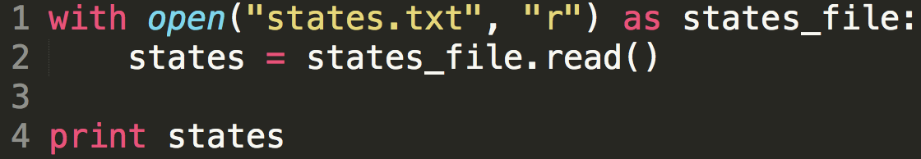
file handling: most common syntax
Notes:
In the next few slides, we'll be exploring each part of the syntax individually.
We'll be going through these slides pretty quickly.

Slide 7
file handling: most common syntax
with keyword: tells Python we're going to do something with a file we're about to open.
When all commands within the indentation have been run, the file is closed automatically.

Slide 8
file handling: most common syntax
open( ) built-in function, tells Python to open a file.
Argument 1: The file you want to open, using relative paths*

Slide 9
Jargon time!
Relative paths are the pathway to your file you want to open relative to where the script you're running lives.
If you save your scripts in …
C:\Users\alison\Desktop\clg\python
or
/Users/alison/Desktop/clg/python
Notes:
First example: windows
Second example: Mac / Linux

Slide 10
relative paths
If you save your scripts in …
C:/Users/Shannon/Desktop/pyclass
or
/Users/shannon/Desktop/pyclass
If your file and script are in the same folder, you can just tell Python the filename! (If not, where is the file you're opening relative to your script?)
Notes:
Emphasize: but make it easy on yourself; put your files and scripts in the same folder.
This works similarly to URLs.

Slide 11
file handling: most common syntax
open( ) built-in function, tells Python to open a file.
Argument 1: The file you want to open, using relative paths
Notes:
This slide is intentionally duplicate — reemphasize the points made here now that we've de-jargoned.

Slide 12
file handling: most common syntax
open( ) built-in function, tells Python to open a file.
Argument 2: The "mode" to open the file in, as a string
r: read-only mode
w: write mode
a: append mode

Slide 13
file handling: most common syntax
The as keyword creates a variable for your file handler.
The variable in this example is states_file, but you could use any variable name you want.

Slide 14
file handling: most common syntax
.read( ) is a file method — a function that only works with file handlers. In this example, the file handler is states_file.
.read( ) will read the entire contents of the file. In line 2 above, I've saved it into the variable states.

Slide 15
file handling: most common syntax
Outcome:
Open a file (states.txt)
Create a variable called states that has the entire contents of the file states.txt
Notes:
Hey Python, can you open up this file? Great! Can you save the full contents of this file into a variable? Awesome, thanks!

Slide 16
Let's try it out
In the python-lessons-cny repo, go to section_07_(files)
Copy/paste or save states.txt onto your computer, in the same folder as your scripts.
Write a script to open states.txt and print the contents of the file.
Notes:
Show folks they can click directly on the states.txt link above to open it in a way that's easily copy-pasteable.

Slide 17
file handling: most common syntax
The variable states is a string containing the contents of your file states.txt.
Notes:
This is really just to recap everything we just did.

Slide 18
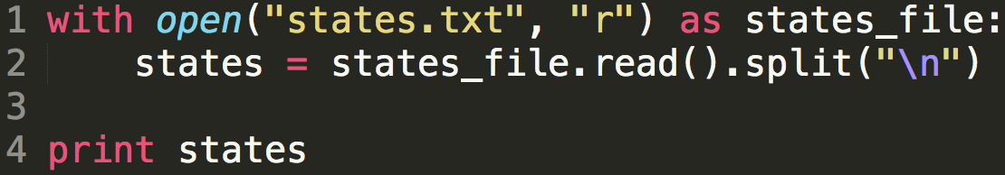
Let's try it out: text files
.read( ) gives us the file contents as a string. If we have a string, we can turn it into a list!
states is now a list rather than a string.
Notes:
Here, the only thing we changed from the previous example was adding
.split("\n")
Take the time to have everyone try it for themselves.

Slide 19
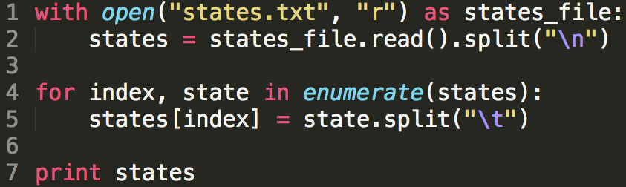
Let's try it out: csv files
In line 5, we split each row into its columns and make those changes stick. We end up with a nested list by line 7.
Notes:
Take a lot of time with lines 4 and 5. It's really challenging.
We need to use enumerate in order to get the position; then we overwrite the list as we loop through it.
At line 2, we split a string into a list; then item by item we loop through that list (the rows) and split out the columns and save it.
By line 7, we see that we have a nested list of lists.

Slide 20
Exercise: part one
As in the previous slide, open either states.txt or states.csv and loop through to create two lists:
One with all of the state names
Another with all of the abbreviations.
Break everything into smaller steps, run and test often!

Slide 21
Exercise: part two
Instead of printing out to the screen, can you loop through your two lists to write to files?
One with all of the state names
Another with all of the abbreviations.
Example of using .write() to write to a file:
Notes:
Note that you'll need the "w" flag (second parameter) to write to a file.

Slide 22
dictionaries: why
How would we …
Create a list of names and Github handles for each student in the class
If we wanted to look up a specific person's Github handle, how could we do that?
… there's got to be a better way
Notes:
Open up Sublime Text and start to create a list. Talk through how to do this without dictionaries, we'd have to loop through every single item and check to see if it's the one we're looking for.

Slide 23
dictionaries: perfect for contact lists
Dictionaries are another way of storing information in Python.
Dictionaries have two components: a key and its corresponding value.
Think of it like a phone book or contact list! If you know my name, (key) you can look up my number (value)!
Notes:
Throwaway joke: eventually no one will know what a "phonebook" is.

Slide 24
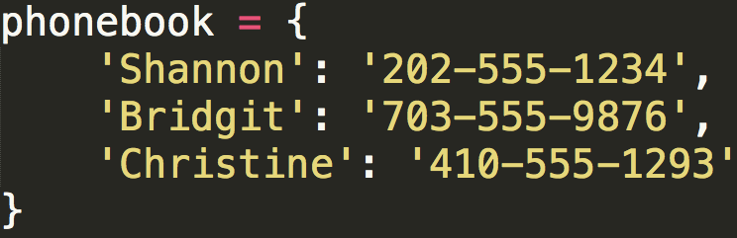
dictionaries: syntax
Creating an empty dictionary:
phonebook = {}
Creating a dictionary with items in it:
Notes:
Use your hands and reinforce key:value. If you know my name, you can look up my phone number.

Slide 25
dictionaries: syntax
Reading part of a string:
name[0:5] # Shann
Reading part of a list:
attendees[:3] # Amy, Jen, Julie
Reading part of a dictionary:
phonebook['Shannon'] # 202-555-1234
Notes:
Emphasize the similarities between slicing a string, slicing a list, and accessing a dictionary. In each case, the syntax uses square brackets and allows us to see part of the larger whole.

Slide 26
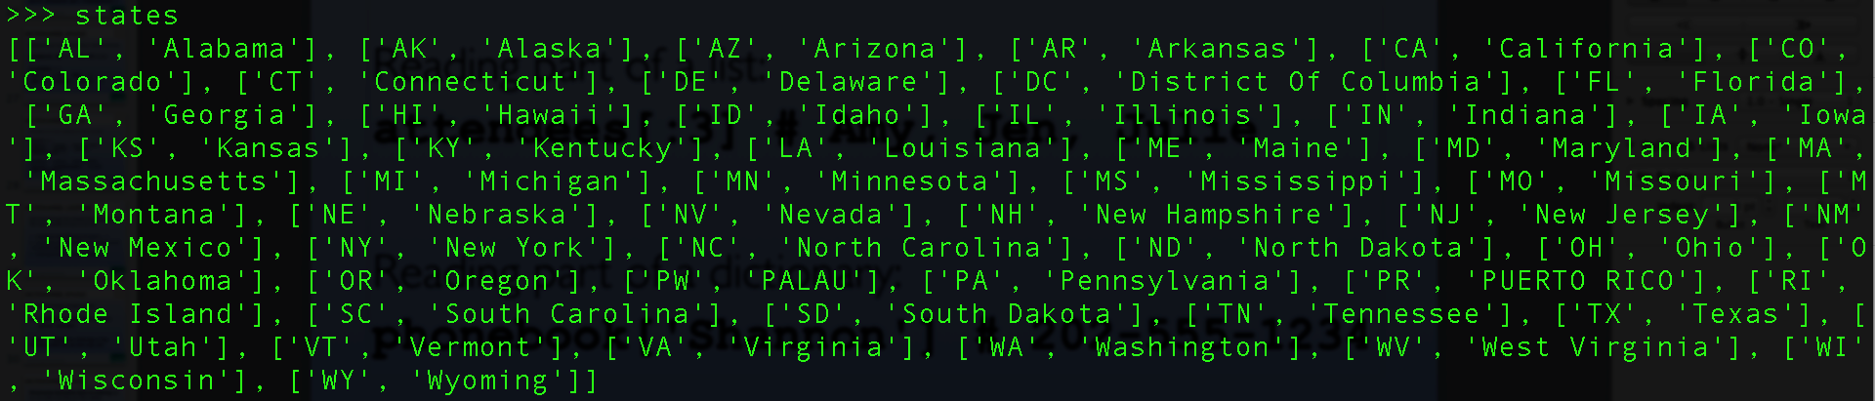
lists within lists
What if we had a list of lists?
This nested list (a list of lists) is a list of each US state. The lists inside have the abbreviation and state name.
Notes:
This seems like an abrupt pivot, but it's important to understanding nested dictionaries, too.

Slide 27



lists within lists
We're already familiar with how to view one item in this list.
But states[0] is also a list! So to view one item in the states[0] list:

Slide 28
lists within lists
What type of object is states? A list.
What type is states[0]?
What type is states[0][1]?
Can I slice those things to see a smaller part?

Slide 29
dictionaries: syntax
Reading part of a string:
name[0:5] # Shann
Reading part of a list:
attendees[:3] # Amy, Jen, Julie
Reading part of a dictionary:
phonebook['Shannon'] # 202-555-1234
Notes:
This slide duplicated for emphasis.
Emphasize the similarities between slicing a string, slicing a list, and accessing a dictionary. In each case, the syntax uses square brackets and allows us to see part of the larger whole.

Slide 30
dictionaries: syntax
Adding to a dictionary:
phonebook['Mel'] = '301-555-1111'
Reading from a dictionary (error prone):
print phonebook['Frankenstein']
Reading from a dictionary (no errors):
print phonebook.get('Frankenstein')
Notes:
Have everyone try this out. What happens? Talk the error out.
Emphasize that getting a KeyError with a dictionary (I don't have this key) is similar to getting an IndexError with a list (I don't have this item)

Slide 31
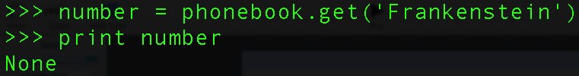
What's none?
None is a special type in python, similar to True or False.
None is returned by the .get( ) dictionary method when it couldn't find the key you're looking for.

Slide 32
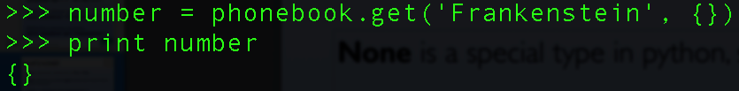
What's none?
By default, .get( ) will give you None when it didn't find the key you were looking for.
But you can tell it to give you a different value — anything you want! A string, an empty dictionary, anything you can think of!

Slide 33
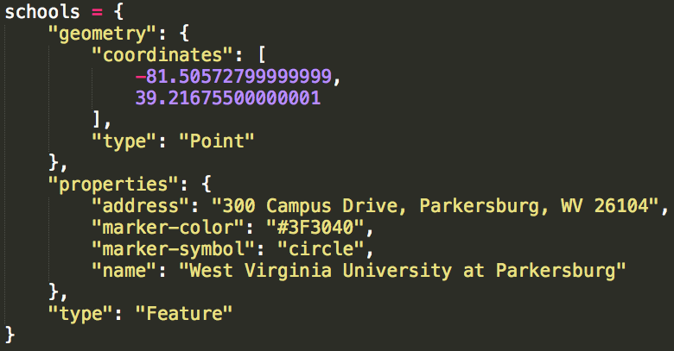
dictionaries: syntax
Dictionaries can contain strings, lists, or other dictionaries.
Notes:
Walk through each key / value pair and point out every single thing in this dictionary.

Slide 34
Quick exercise
Exercise instructions are here - open this link, save it to your computer, open it in Sublime/IDLE and work from there!

Slide 35
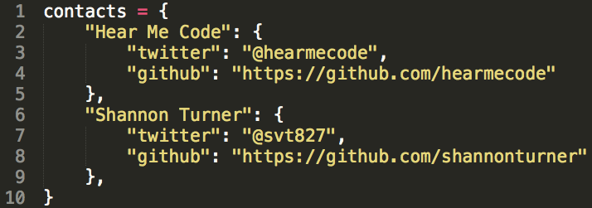
exercise
Exercise instructions are here - open this link, save it to your computer, open it in Sublime/IDLE and work from there!
Just do #1 for now. Once we've added items to our dictionary, we'll see how to loop through it in the next slides.

Slide 36
dictionaries: Looping
Let's loop through the contacts list we just created. We have a handful of ways to do this.
Looping by keys (Shannon, Hear Me Code, everyone else at your table…)
Looping by key / value pairs together

Slide 37

dictionary methods
.keys() will create a list of all of the keys in your dictionary.
Because dictionaries are unordered, you might get keys in a different order than you see below, or a different order than you put them in. That's okay.

Slide 38
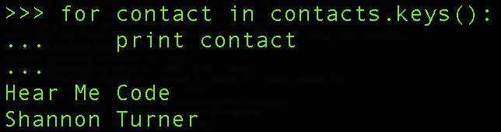
dictionary methods
.keys() will create a list of all of the keys in your dictionary.
If you have a list, you can loop over it!

Slide 39
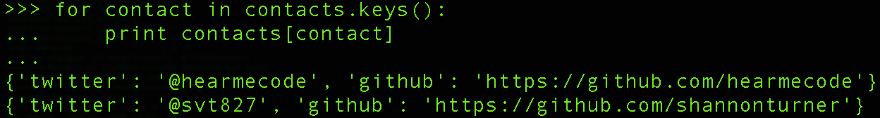
dictionary methods
.keys() will create a list of all of the keys in your dictionary.
If you have a list, you can loop over it!

Slide 40

dictionaries are unordered
Dictionaries themselves have no ordering, but we can order their keys:
sorted() is a built-in function that sorts a list.
Notes:
Re-emphasize that you cannot rely on the ordering of a dictionary, you can only order lists of its keys.

Slide 41
dictionary methods
.items() will create a list of all of the key/value pairs in your dictionary.
As with .keys(), if we have a list, we can loop over it. .items() gives us a list of lists!
Notes:
Remind everyone that dictionaries are unordered, so you might see things in a different order and that's okay

Slide 42
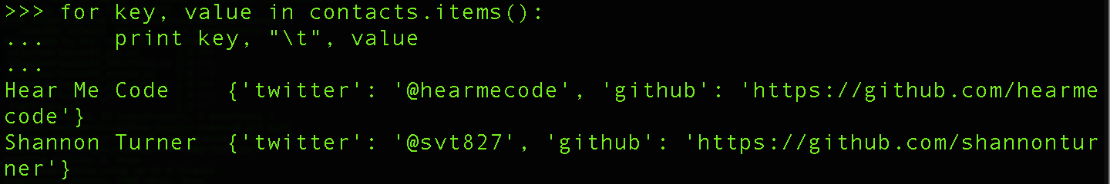
dictionary methods
.items() will create a list of all of the key/value pairs in your dictionary.
How could you loop through a nested dictionary?
Notes:
Remind everyone that dictionaries are unordered, so you might see things in a different order and that's okay

Slide 43
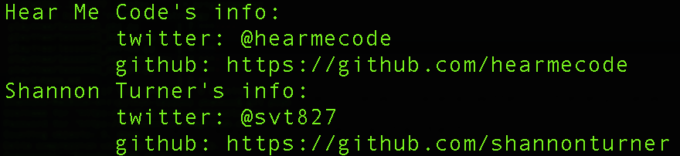
Exercise: part 2
Loop through the contacts dictionary to display everyone's contact information, like this:
Notes:
Mention that not everyone will have a twitter; that's okay! Dictionaries can handle it :)

Slide 44
playtime!
In the CLG GitHub python-lessons-cny repo, go to the code exercises > playtime folder:
Beginner: US States tables
Beginner: Contacts list
Advanced: Comparing two CSVs

